Slide 1
USIU-AFRICA HACKTAHON 2019
Group 1
Whoopie Wanja
Kevin Nyakundi
Zablon Owino
Alice Akoth
Austin Owour

Slide 2

MAMA HEALTH
Infant Mortality

Slide 3
Technology
Tools; -Afrikas Talking API, Python, Flask,
Methodologies; - sourcing information on pregnant women ; health, midwives, Infants and The high death rates of newborn babies, infants.
How It Works;
Mama Health is an ussd application that helps on health and offer services to provide pregnant women and your unborn baby

Slide 4
User Acquisition
We plan to acquire users by utilizing:
Social Media - Twitter & Facebook
Word of Mouth
Posters & Flyers in Hospitals and Other Health Centers
Google Ads and facebook Ads

Slide 5
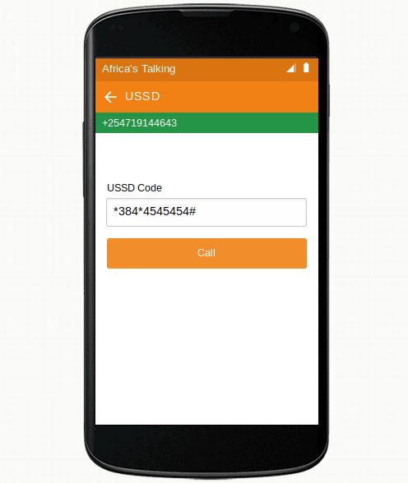
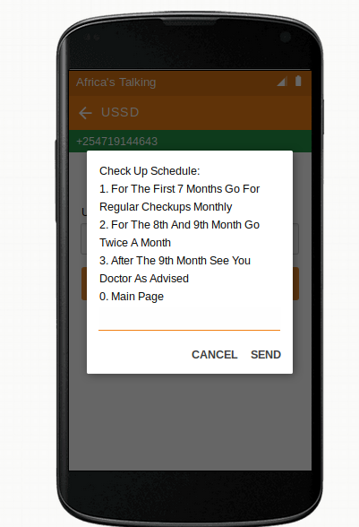
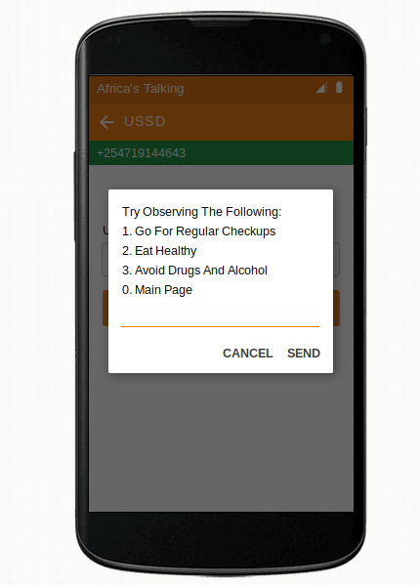
User Experience

Slide 6
USIU-AFRICA HACKATHON 2019
Thank You

